Slide 1
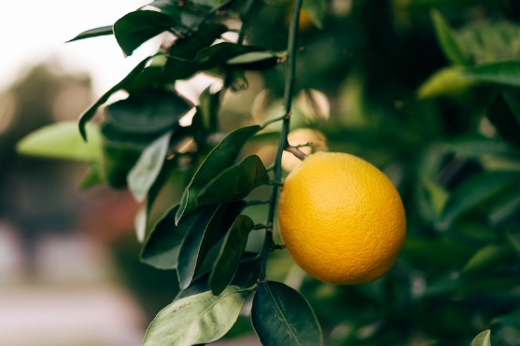
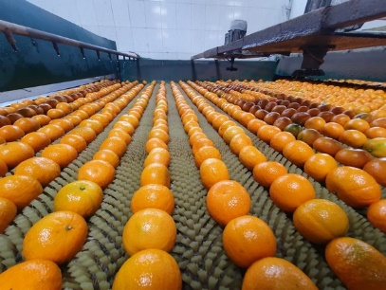
CITRUS STATISTICS: 2020 EXPORT SEASON
The citrus industry
continues to grow
& create direct jobs
The citrus industry continues to be one of the critical industries that create 160 000 direct jobs & earn approximately R20 billion from exports only. South Africa (SA) exports two million tons of citrus annually, making it the 2nd highest global exporter of citrus. Citrus comprises of oranges, lemons, grapefruits and soft citrus.

Slide 2
CITRUS STATISTICS: 2020 EXPORT SEASON
The citrus industry
work process
This is a long process that requires season
planning & follows synergy of steps, for citrus:
Harvesting;
Sorting;
Washing;
Transportation;
Inspection;
Loading, and related aspects.
All this is conducted by essential workers during the SA COVID-19 lockdown period.

Slide 3
CITRUS STATISTICS: 2020 EXPORT SEASON
Thank you for
making the citrus
industry a success
The department extends its appreciation to everyone who makes the citrus industry successful, and more importantly, the essential workers & the departmental officials, who continue to work tirelessly under trying conditions in pursuit of local & global food security. To everyone who heeded to the call of our President and went the extra mile, we thank you!

Slide 4
CITRUS STATISTICS: 2020 EXPORT SEASON
Break-bulk shipment
doubles up
The break-bulk shipment to China has doubled this season in 2020. The year 2019 was historical, as the South African citrus industry marked its maiden break-bulk shipment of citrus through a specialised reefer vessel to Japan & China. In the same year, there were only 7 break-bulk vessels (4 co-loaded for Japan & China citrus).
8 break-bulk vessels (6 vessels co-loaded Japan and China citrus – 2 vessels had only Japan citrus)
China – 7 329 pallets, 7 215 tons (316 030 cartons grapefruit, oranges, and soft citrus)
Japan – 28 107 pallets, 25 586 tons (1 588 304 cartons, grapefruit, oranges, and lemons)

